Slide 1

Analysis of Human Papillomavirus type-16 & -18 Lineages in Iranian Women based on Long Control Gene Region
Seyed Alireza Nadji, Ph.D.
Associate Professor of Medical Virology
Head, Virology Research Center (vrc.sbmu.ac.ir)
  Director, Iran National HPV reference Laboratory
NRITLD, SBUMS
Tehran, IRAN
18 June, 2016
EUROGIN 2016
Salzburg-Austria

Slide 2

Carcinogenicity and Genetic variation of HPV-16 & -18
HPV16 & 18 are powerful carcinogenic type
  causing approximately 70% of cervical cancer and most other HPV-related cancers
For unknown reasons, there is huge variability in risk conferred by different HPV types
  remarkably, strong differences even between closely related variant lineages within each type
Therefore, important genetic information linked to carcinogenic potential must be embedded in the small HPV genome

Slide 3
HPV-16 & -18 Lineages
Nine HPV16 variant sub-lineages
  EUR, As, AFR1a, AFR1b, AFR2a, AFR2b, NA, AA1 and AA2
Three major lineages (A, B, C)
additional sub-lineages
(A1 to A5 and B1 to B3)
(A1 and A2=AA, A3 to A5=E, and B/C AFR)
Cornet et al. /Journal of Virology 86 (2012) 6855–6861
R.D. Burk et al./Virology 445 (2013) 232–243

Slide 4
Biology of HPV lineages
HPV16 variants
HPV18 variants
Cervical pathogenesis
  Most studies implicate the non- European, mostly Asian, as being more pathogenic in comparison to isolates from the European lineage
Persistence
  The magnitude of the effect (NE vs. E) is ≈2-fold of persistency
Precancer
  NE lineages compared to E isolates, with a 2–4 fold increase for cervical neoplasia
There is a lack of clear evidence for HPV18 variants role in different stages of the pathogenesis and persistency
R.D. Burk et al./Virology 445 (2013) 232–243

Slide 5
Cervical cancer incidence in Iran
Data accessed on 15 Nov 2015.
Incidence data is available from high quality regional (coverage lower than 10%). Data is included in Cancer incidence in Five Continents (CI5) volume IX and/or X. Incidence rates were
estimated as the weighted average of the local rates. For more detailed methods of estimation please refer to http://globocan.iarc.fr/old/method/method.asp?country=364
aRates per 100,000 women per year.
b Cumulative risk (incidence) is the probability or risk of individuals getting from the disease during ages 0-74 years. For cancer, it is expressed as the % of new born children who would be
expected to develop from a particular cancer before the age of 75 if they had the rates of cancer observed in the period in the absence of competing causes.
Data sources:
Ferlay J, Soerjomataram I, Ervik M, Dikshit R, Eser S, Mathers C, Rebelo M, Parkin DM, Forman D, Bray F. GLOBOCAN 2012 v1.2, Cancer Incidence and Mortality Worldwide:
IARC CancerBase No. 11 [Internet]. Lyon, France: International Agency for Research on Cancer; 2013. Available from: http://globocan.iarc.fr.

Slide 6
Age-standardized incidence rates of cervical cancer of Iran
(estimations for 2012)
Age-specific incidence rates of cervical cancer in Iran compared to its region and the world
Data accessed on 15 Nov 2015.
Rates per 100,000 women per year.
Data sources:
Ferlay J, Soerjomataram I, Ervik M, Dikshit R, Eser S, Mathers C, Rebelo M, Parkin DM, Forman D, Bray F. GLOBOCAN 2012 v1.2,
Cancer Incidence and Mortality Worldwide: IARC CancerBase No. 11 [Internet]. Lyon, France: International Agency for Research on Cancer; 2013.
Available from: http://globocan.iarc.fr.

Slide 7
Clinical Samples subjected to HPV screening & genotyping
5’500 ThinPrep samples
Iranian females, age 16-45
11 provinces

Slide 8

Studied Samples
*The samples were added to the study from addicted females from Tehran province who referred to the Khourshid Institute dependent on Tehran municipally
[International Journal of Gynecology & Obstetrics 108 (3), 254-255]

Slide 9

Molecular Phylogenetic analysis of HPV-16 Lineages by Maximum Likelihood method
EP1
NA1
AF2
Samples with small black triangle were under studied

Slide 10

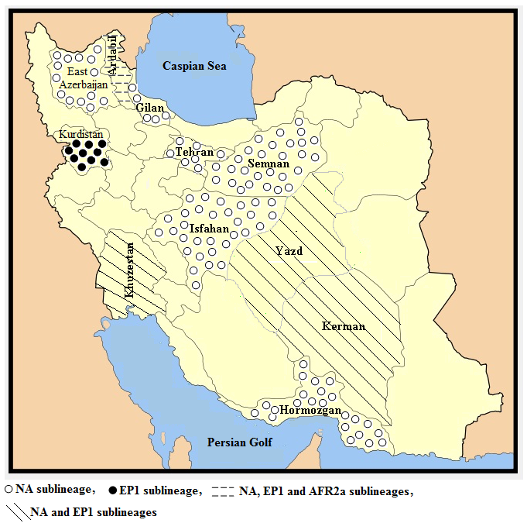
Schematic figure of distribution of HPV-16 lineages in 11 provinces in Iran

Slide 11
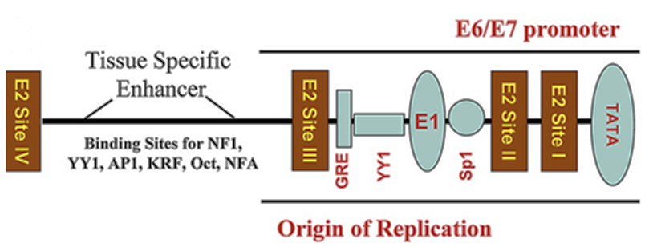
LCR gene region (URR)
non-coding upstream regulatory region (URR) contains DNA-protein binding motifs and is involved in replication
  promoter p97, enhancer, different binding sites and origin of replication (Ori)
Mutation in LCR at YY1-motifs is one of the mechanisms for enhancing viral oncogene expression during the course of cancer cell progression

Slide 12
All nucleotide variations in studied HPV-16 isolates
Ref = HPV-16 prototype (NC001526), AA= Asian American, NA= North American, EUR= European, EP1= European Prototype 1

Slide 13
New nucleic variations observed amongst HPV-16 isolates in IRAN
Ref = HPV-16 prototype (NC001526), AA= Asian American, NA= North American, EUR= European, EP1= European Prototype 1
Notes:
New signature mutations observed amongst Iranian HPV-16 isolates. The nucleotide positions of detected mutations are written vertically across the top and are indicated by the corresponding nucleotide letter. The absence of variations relative to the prototype is represented by dashes. Ref = HPV-16 prototype (NC001526), AA= Asian American, NA= North American, EUR= European, EP1= European Prototype 1

Slide 14

Phylogenetic tree of HPV-18 variants
Samples with small black triangle were under studied

Slide 15

All HPV-16 sequences determined in this study have been deposited in the GenBank database

Slide 16
Conclusion
Iran is deferent from other Asian countries in HPV-16 & -18 lineages and Cervical cancer incidence
  Most of lineages belong to European and North American sub-lineages
    the non-European HPV16 variant lineages (mostly Asian lineage) are associated with an increased risk, estimated up to 10- fold, of invasive cancer compared to European variants
  More investigation is needed to find out the reason of low incidence of cervical cancer

Slide 17
Acknowledgments
M. Mobini Kesheh, M. Barazandeh, S. Sharif Kashani
  Virology Research Center, NRITLD, Shahid Beheshti University of Medical Sciences, Tehran, Iran
  National HPV reference Laboratory, Tehran, Iran
S. M. Samiee, Ph.D.
  Reference Health Laboratory, Ministry of Health and Medical Education, Iran
A. Motlagh, M.D.
  Cancer Office, Non-Communicable Diseases, Deputy of Health, Ministry of Health and Medical Education, Tehran, Iran

Slide 18

Thank you for your patience ☺

Slide 19
