Slide 1

Cervical Cancer Screening
S.A. Nadji, PhD
Associate professor of virology
Head, Virology research center, nritld, sbmu

Slide 2
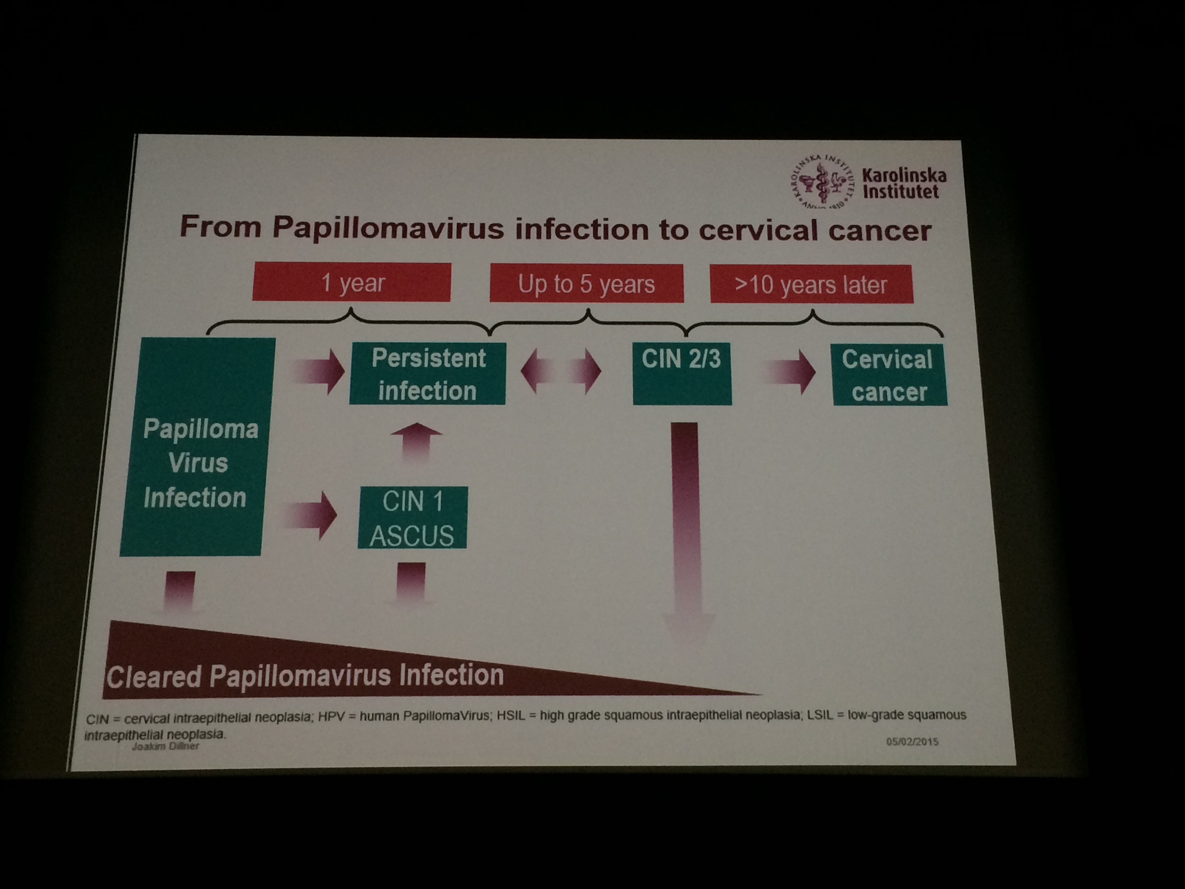

Slide 3
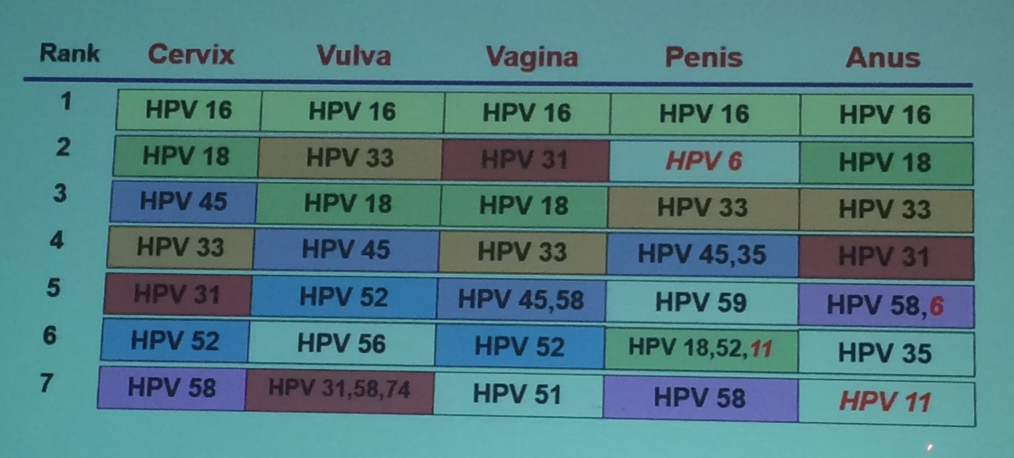
Ranking of the 7 most common HPV types
Type distribution for nearly 30’000 HPV related cancers from 38 countries participants in ICO surveys 2005 - 2014

Slide 4
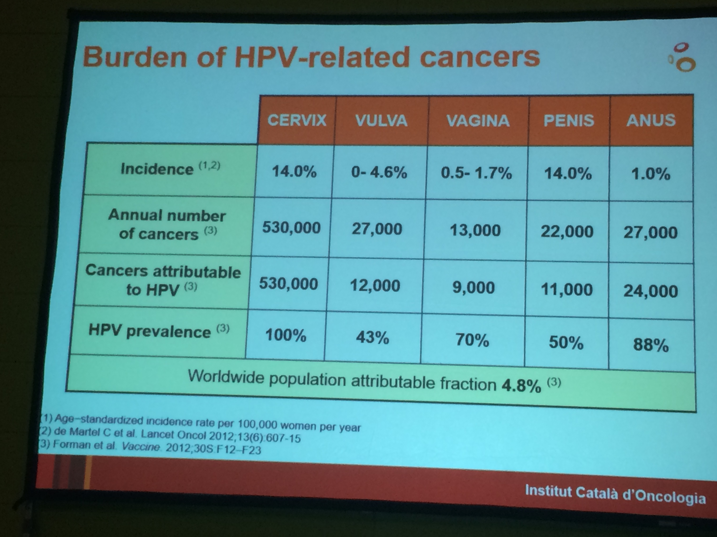
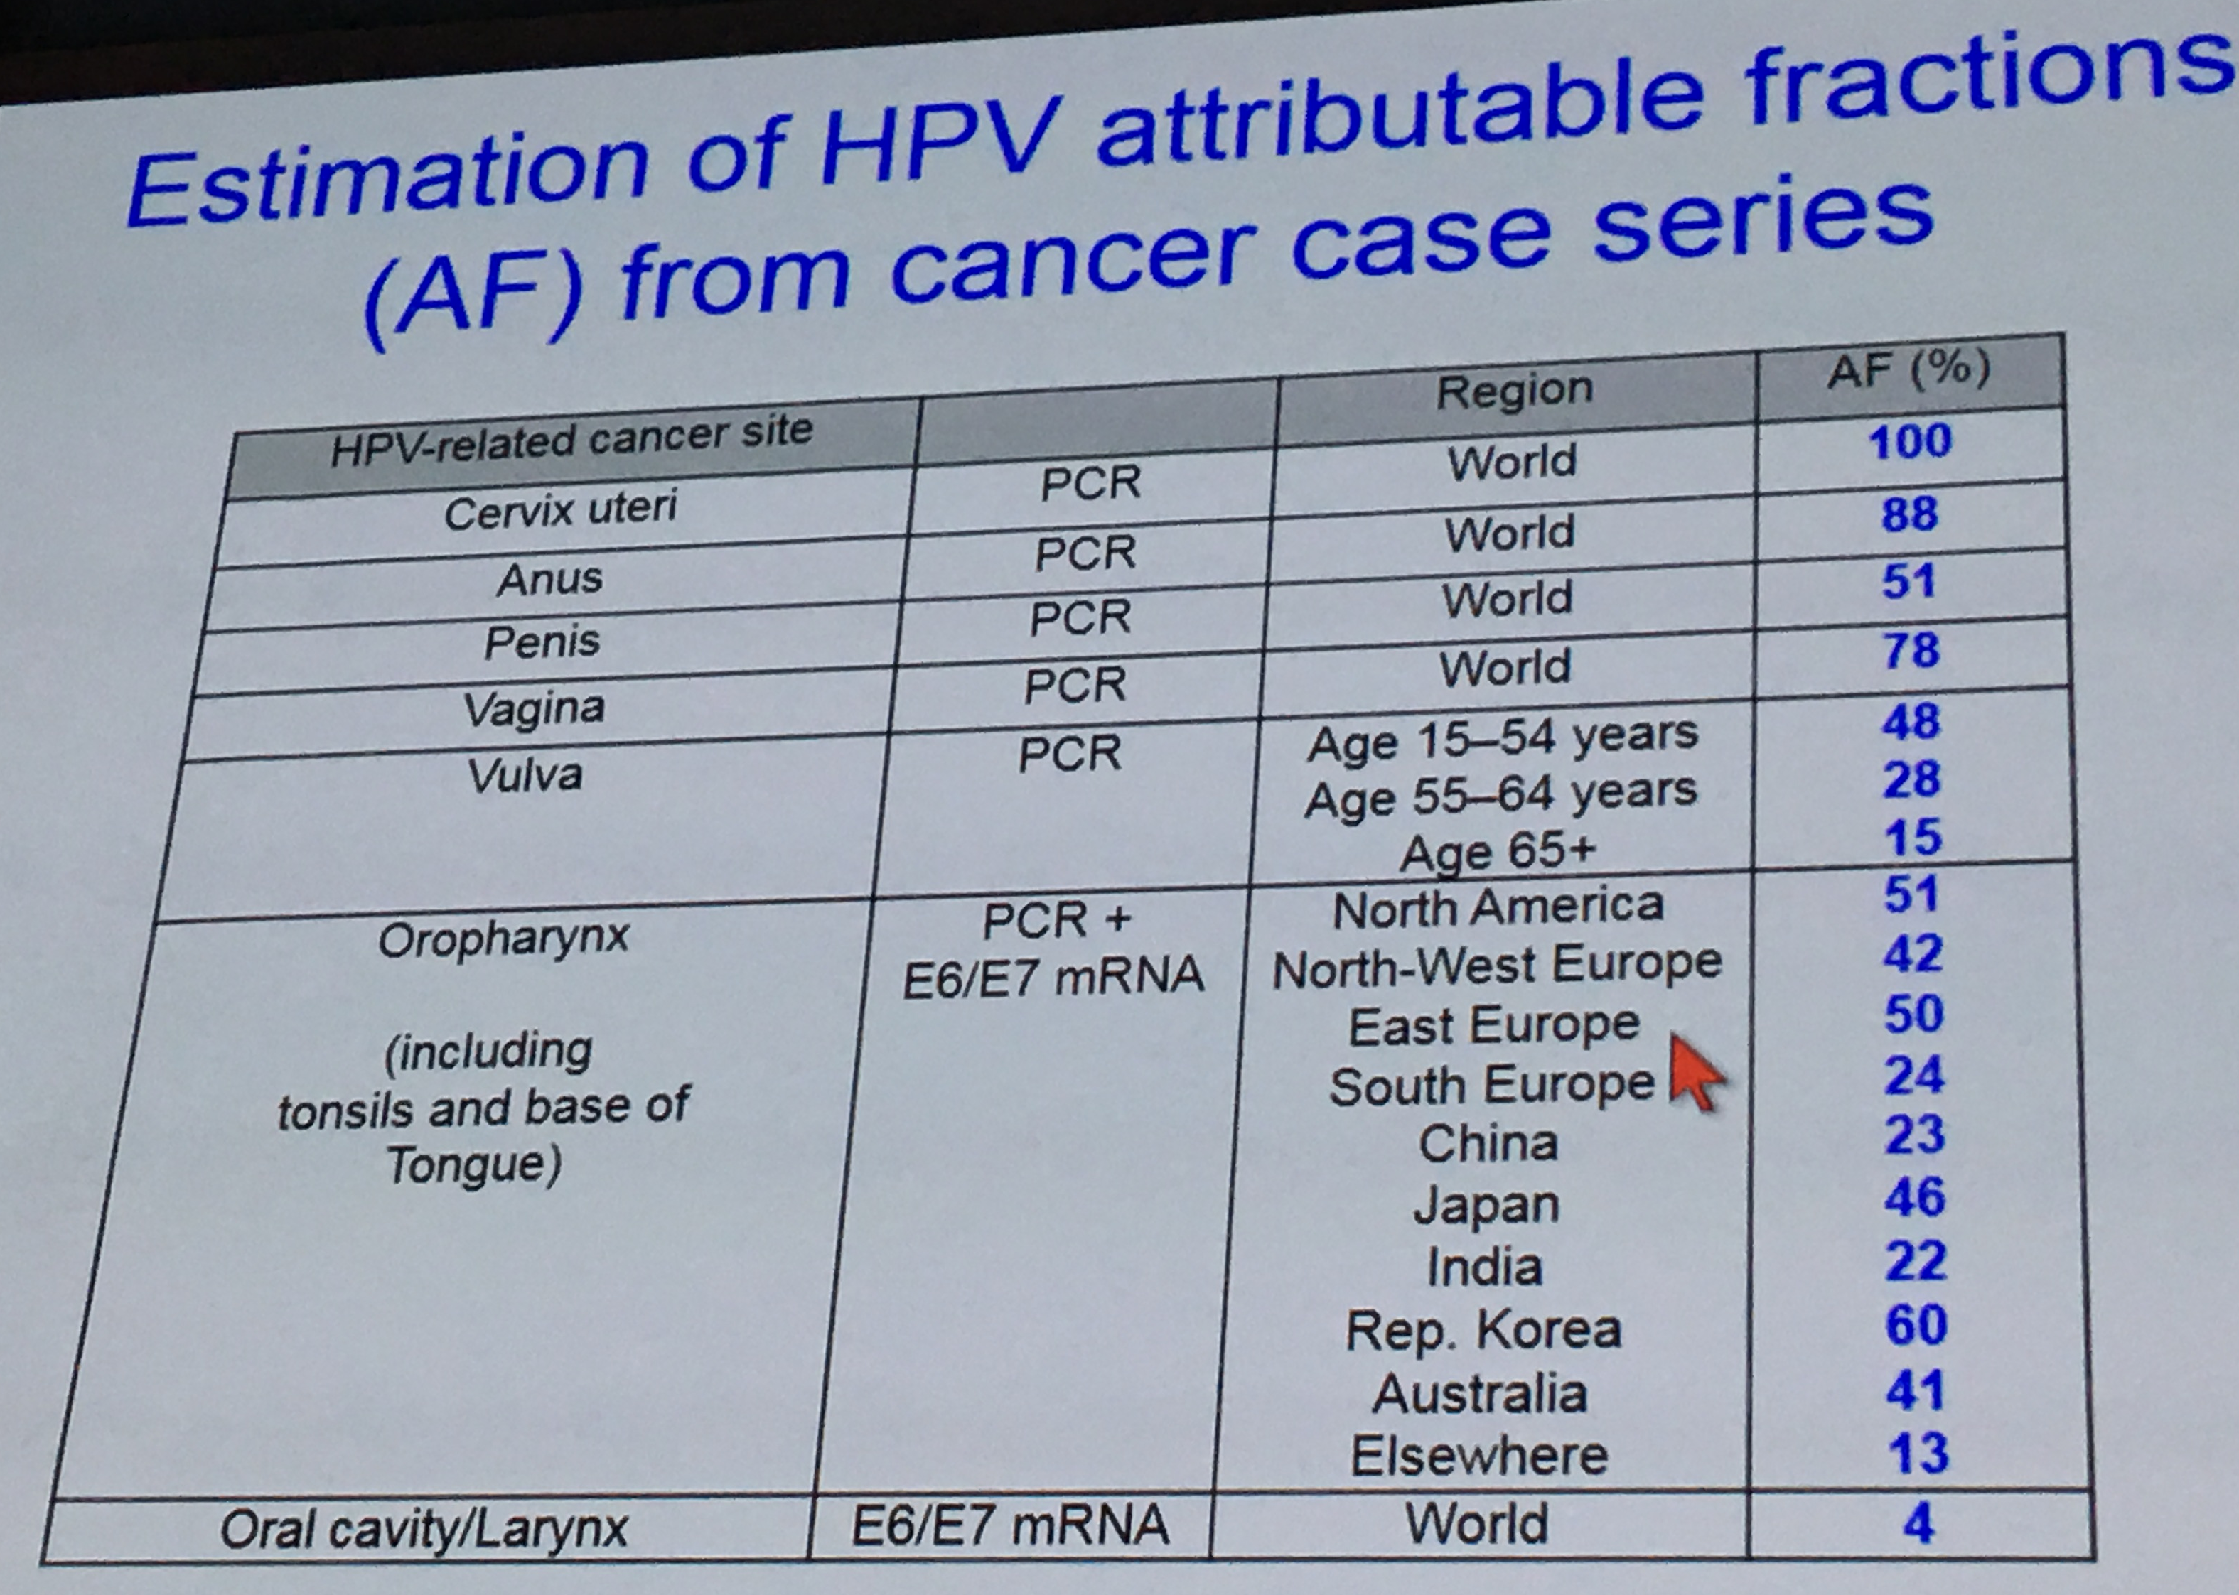
Burden of HPV related Cancers

Slide 5
HPV PREVALENCE IN IRANIAN FEMALES
HPV screening, 2011
HPV screening in addicted females,2009
STI screening in Vulnerable women,2015
5353 ThinPreps, 11 provinces
320 HPV+ (6%)
  99 HR-HPV (31%) [type16/18]
  36 LR-HPV (11.3%) [type 6/11]
118 vaginal swabs, TEHRAN
59 HPV+ (50%)
11 HR-HPV (19%) [type16/18]
Int J Gynecol Obstet,
2009
With collaboration of 15 Medical Science Universities
1337 vaginal swabs, 13 provinces
559 Human Papillomavirus: 41.8% (95%CI: 39.2, 44.5)
144 HR-HPV (25.8%) [type16/18]
• other STI prevalence
  Syphilis 0.4% (95%CI: 0.2, 1.0); Gonorrhea: 1.3% (95%CI: 0.8, 2.1); Chlamydia: 6.0% (95% CI: 4.8, 7.4); Trichomoniasis: 11.9% (95% CI: 8.5, 16.5);

Slide 7
Objective of Screening
Prevent morbidity and mortality from cervical cancer
Prevent overzealous management of precursor lesions that most likely will regress or disappear and for which the risks of management outweigh the benefits

Slide 8
How good is Cytology in Cervical cancer Screening?
Duke report (Nada et al.,2000): sensitivity= 51% & specificity= 98%
Pooled analysis of European and Canadian Studies (Cuzick et al.,2006): sensitivity= 53% & specificity= 96%
Cytology Screening programs have to compensate for the low sensitivity by acquiring 2-3 annual cytology tests

Slide 9
Other Issue to consider with Cytology
Highly subjective test: substantial inter- and intra- laboratory variability and limited reproducibility, particularly for equivocal and low grade test results
Unable to identify women at future risk of developing cervical cancer precursors
Unclear how cytology will perform as HPV vaccine uptake rates increase

Slide 10
New ACS/ASCCP/ASCP Guidelines when to begin screening
Cervical cancer screening should begin at age 21
Women <21 should not be screened regardless of age of sexual onset
Saslow D, Solomon d, Lawson h, …. Ca: a cancer j for clinicians, 2012, 62(3):147-72

Slide 11
2012 ACS/ASCCP/ASCP screening guidelines
Screening for age 21-29
Screening for age 30-64
Cytology alone every 3 years
HPV testing “should not be used to screen”
  Not as a component of contesting
  Not as a primary stand –alone screen
Cytology + HPV testing (contesting) every 5 years is PREFERRED
Cytology alone every 3 years is ACCEPTABLE

Slide 12
HPV Testing into Primary Screening
Cotesting vs. Primary stand -alone HPV testing

Slide 13
RCTs of HPV Testing in Screening
POBASCAN study: the Netherlands (Mej\ijer et al., Int J Cancer 2004; Bulkmans et al., Lancet 2007)
Indian Trial (Osmanabad) (Sankaranarayanan et al. NEJM 2009)
ARTISTIC trial: UK (Kitchener et al. Lancet Oncol 2009)
NTCC Italian Study (Ronco et al., Lancet Oncol, 2006; JNCI 2006)
SWEDESCREEN: Swedish trial( Elfgren et al., AJOG 2005; Naucler et al., NEJM 2007; JNCI 2009)
Finnish RCT (Kotaniemi et al., BJC 2005; Eur J Cancer 2008; IJC 2008; Leinonen et al., JNCI 2009)
CCCaST study: Canada (Mayrand et al., IJC 2006; NEJM 2007)
BC RCT (HPV FOCAL): Canada (Ogilvie et al., Br J Cancer 2012)
Athena Trial: United States (Wright, et al., GynOnc 2015)

Slide 14
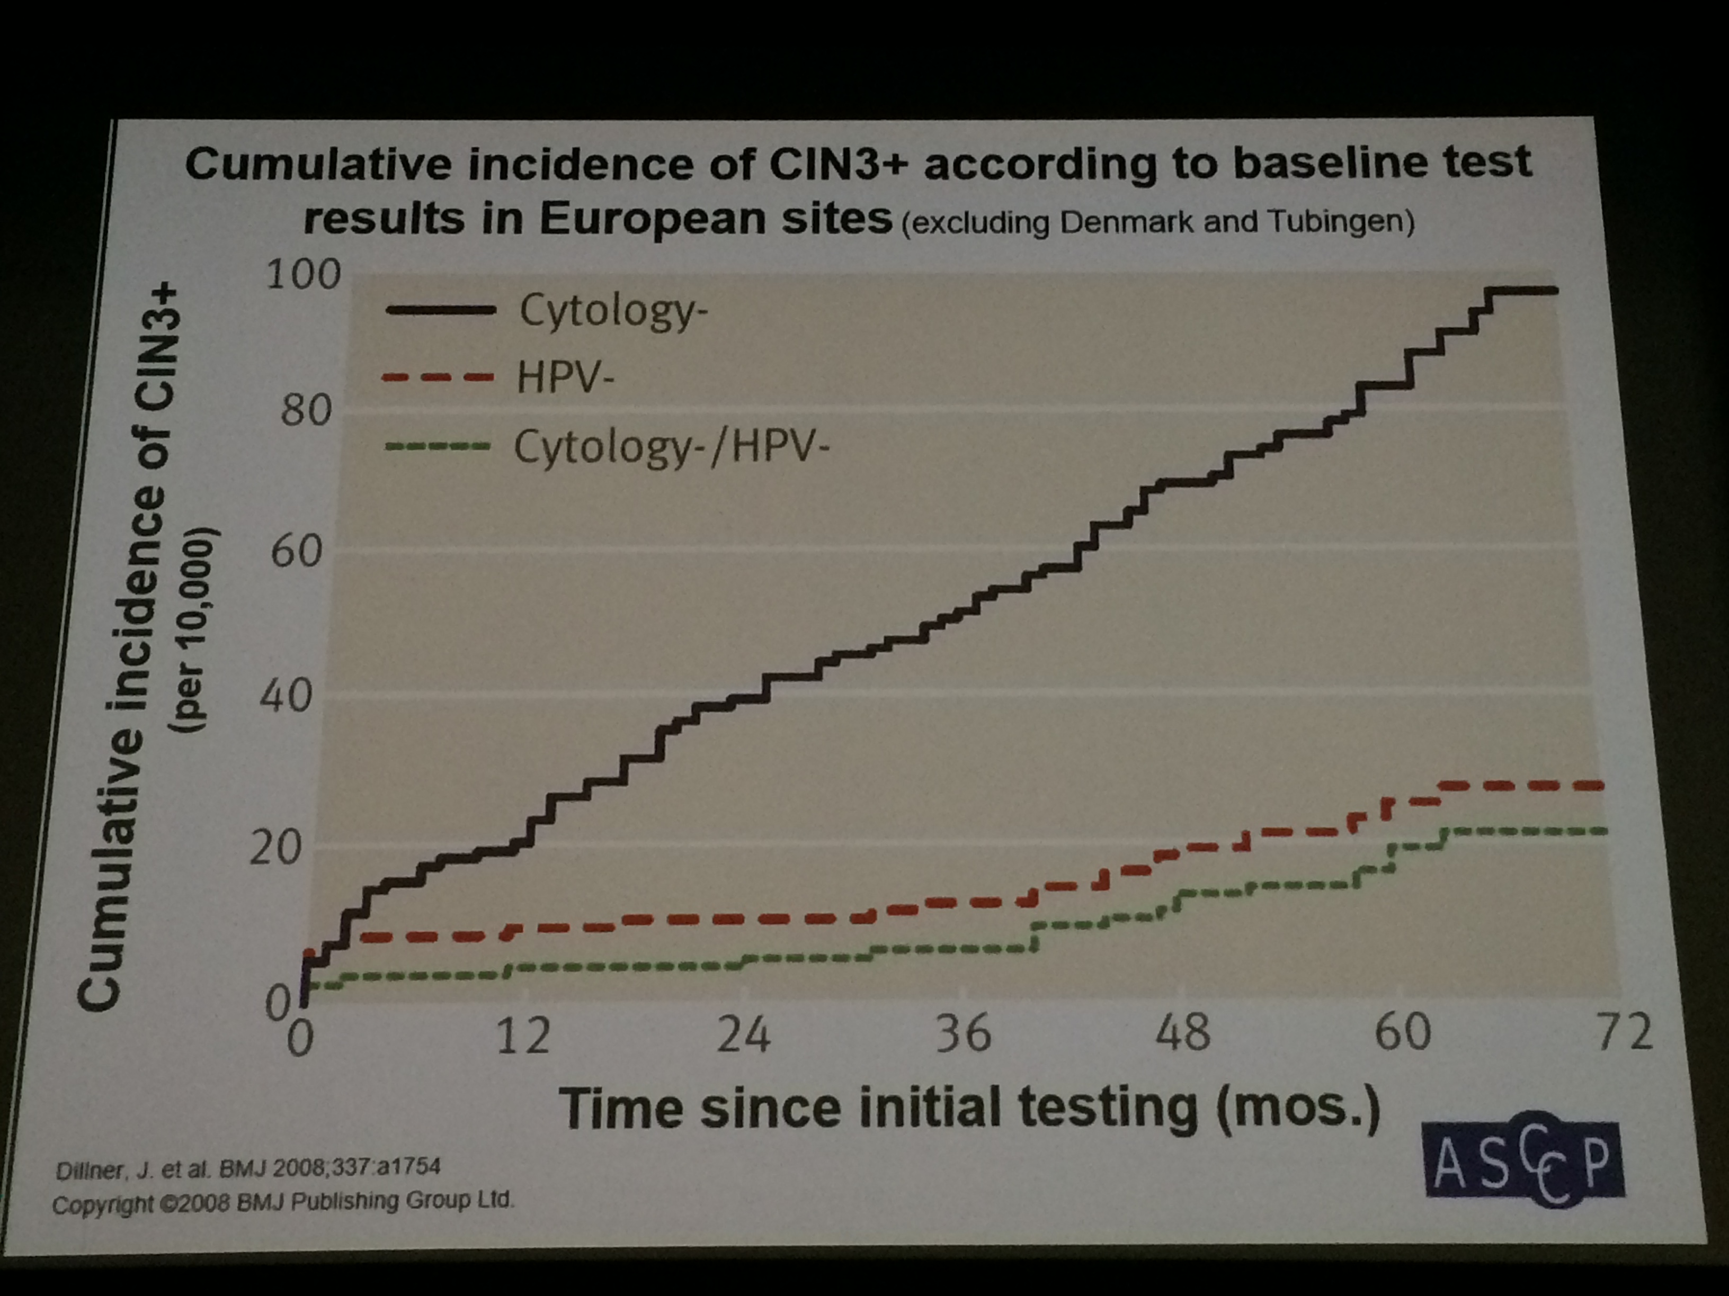

Slide 15
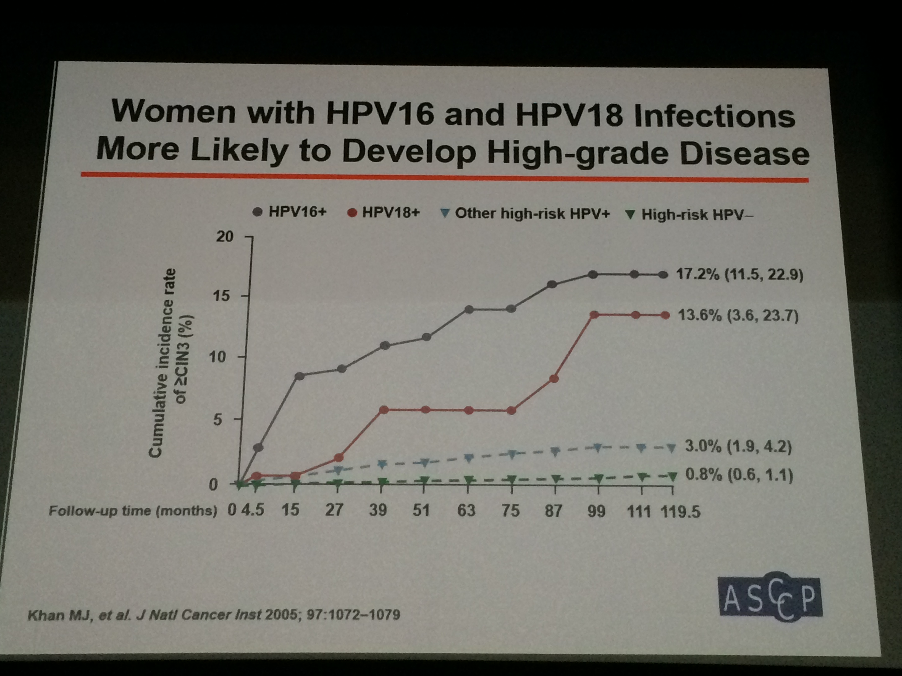

Slide 16
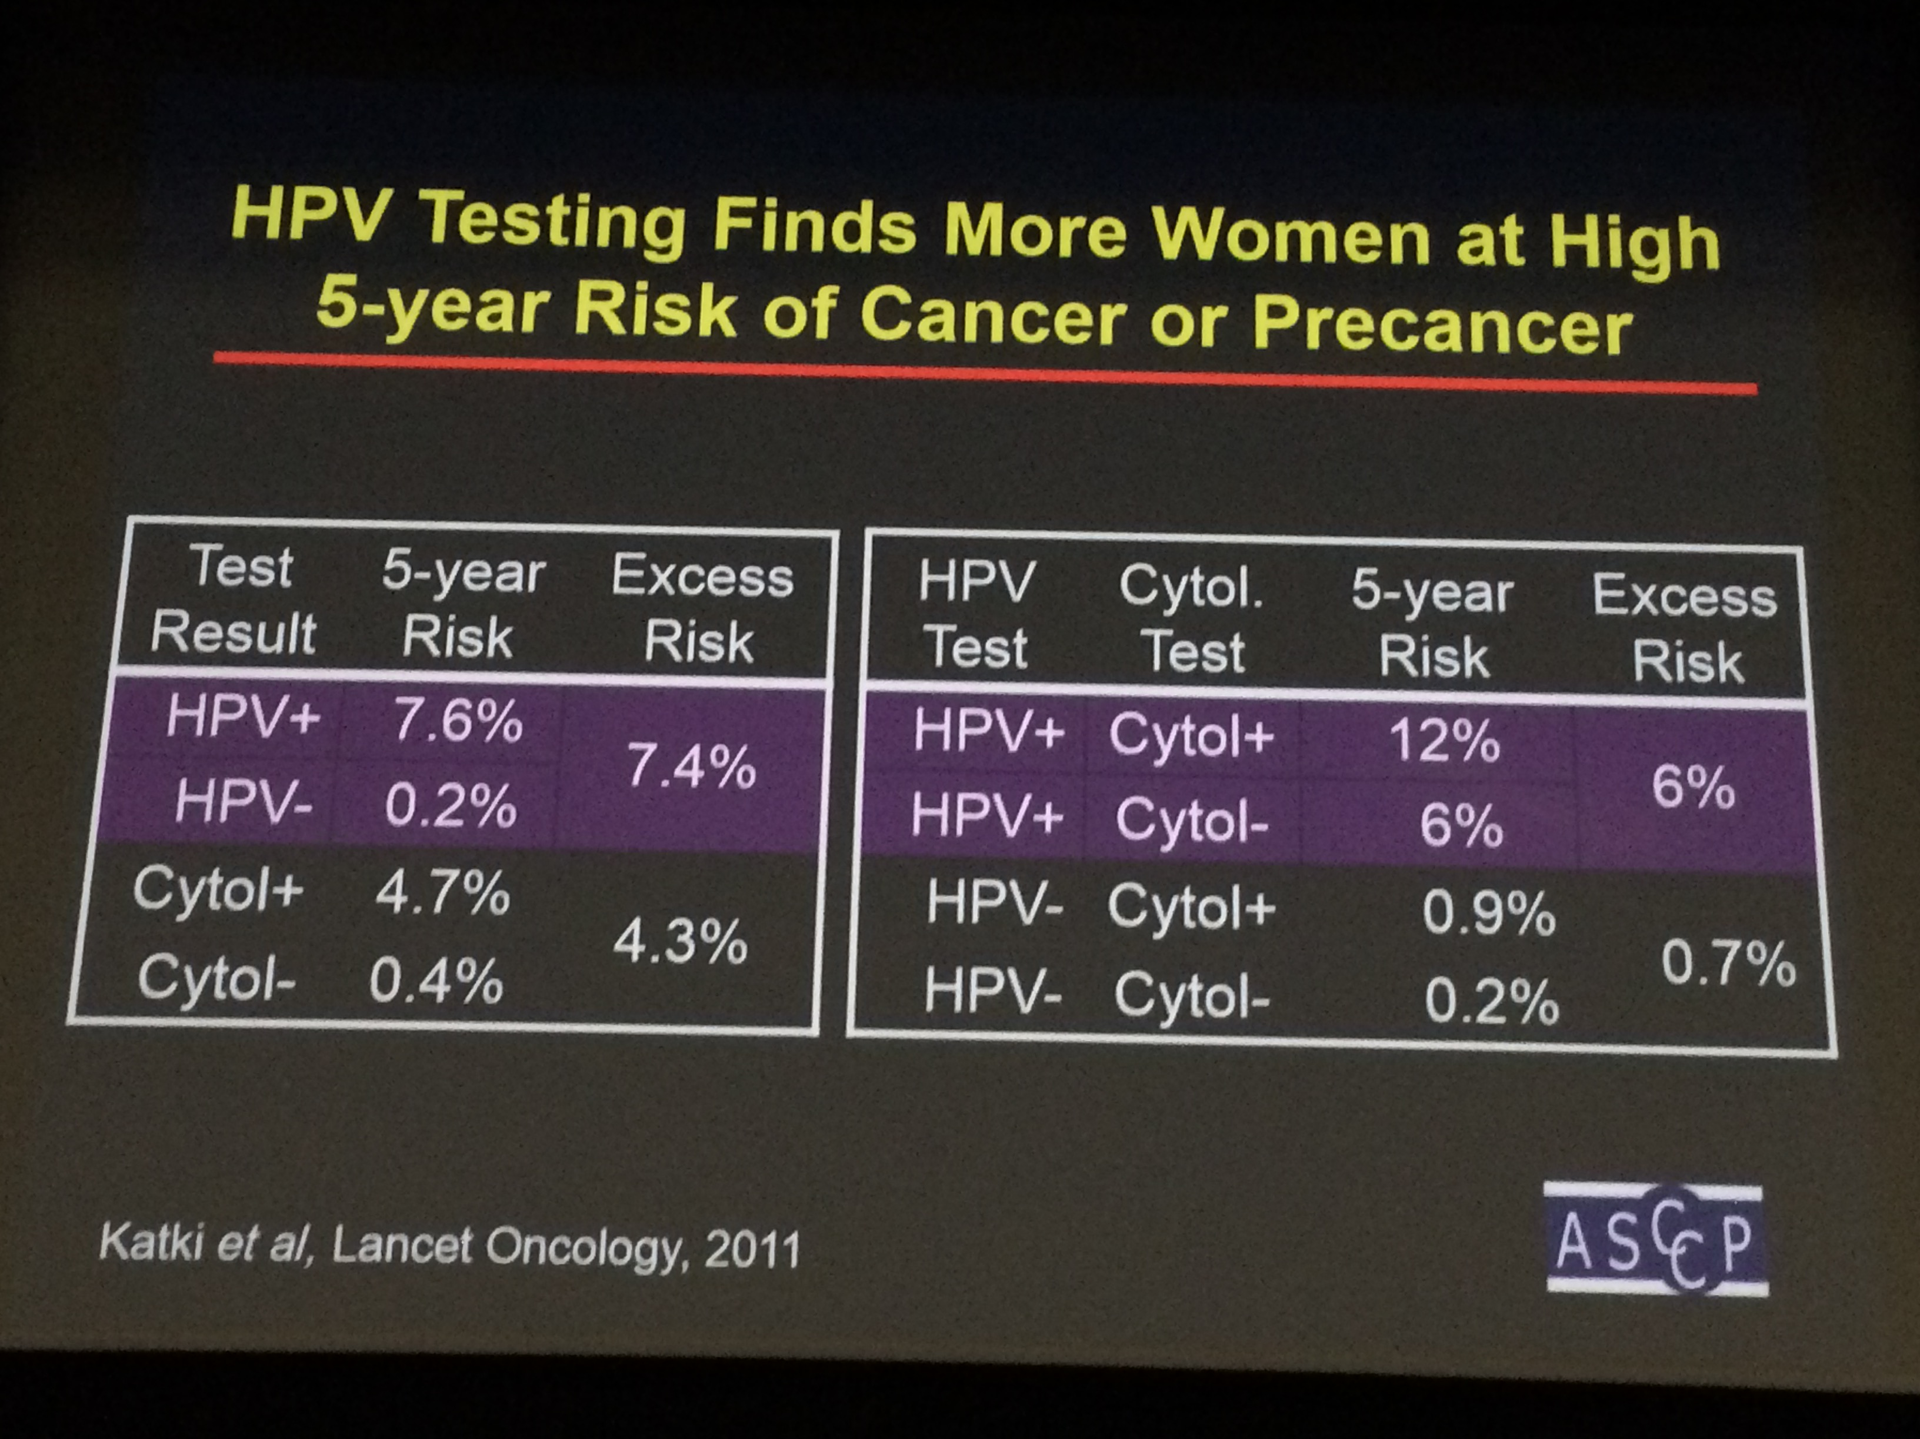
HPV Testing Finds More Women at High 5- year Risk of Cancer or Precancer
Katki et al, Lancet Oncology, 2011

Slide 17
Why is HPV DNA Testing an Attractive Option for Cervical Cancer Screening?
More sensitive and reproducible than cytology
More “upstream” in carcinogenic process, thus enabling a longer safety margin for screening intervals
Assesses future risk (and not just the presence of current disease)
Can be automated, centralized, and quality- checked for large specimen throughput
May be more cost- effective than cytology if deployed for high volume testing, such as primary screening
A more logic choice for screening women vaccinated against HPV infection.

Slide 18
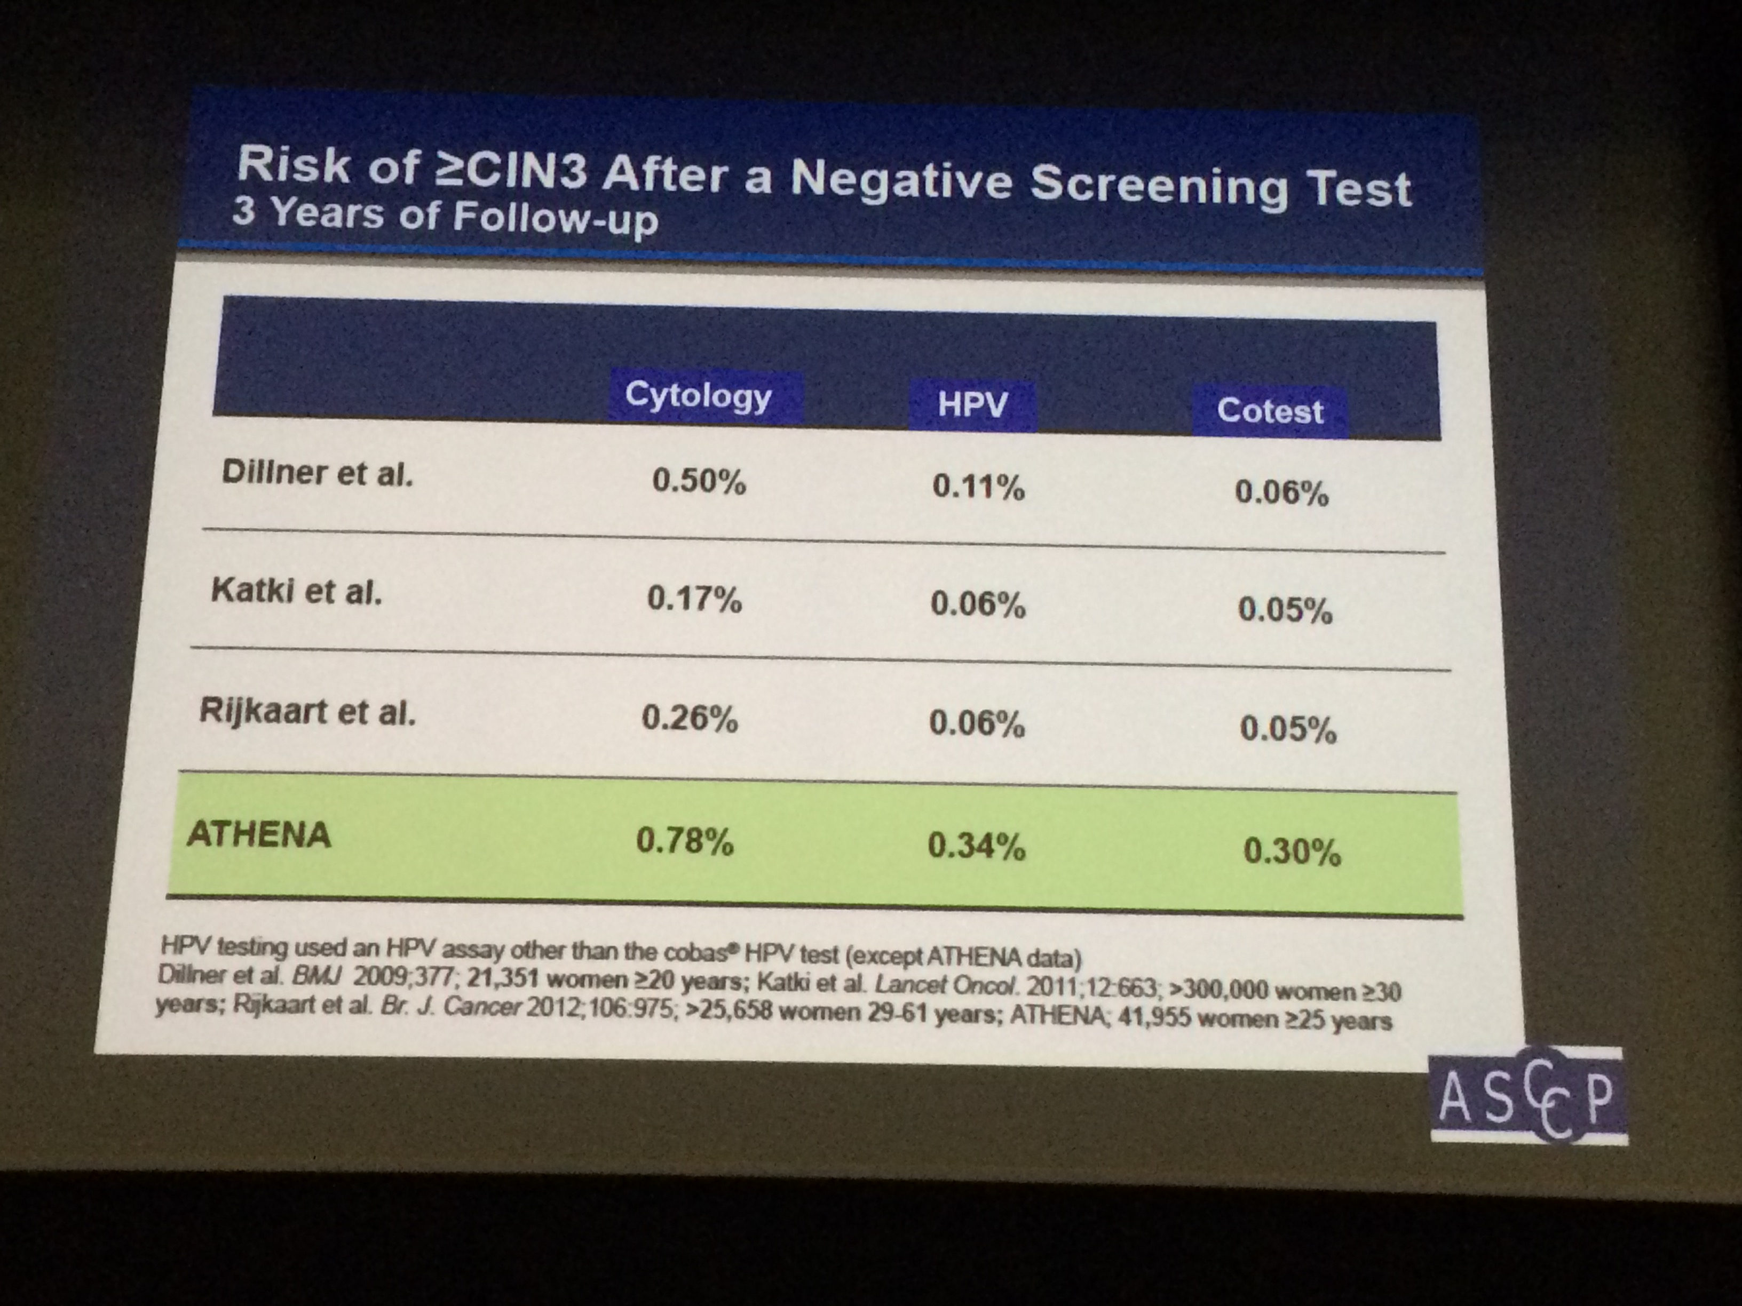

Slide 19
HPV As an Initial Screening Test
Proposed Primary Screening Algorithm
HPV with 16/18 genotyping and reflex cytology
From 3/12/2014 FDA panel Materials

Slide 20
HPV Primary Screening for
Cervical Cancer
Because of equivalent or superior effectiveness, primary hrHPV screening can be considered as best alternative to current cervical cancer screening methods.
Based on limited data, triage of HPV+ women using a combination of genotyping for HPV16&18 and reflex cytology for women + for the 12 other HPV genotypes appears to be a reasonable approach to managing HPV + women.

Slide 21
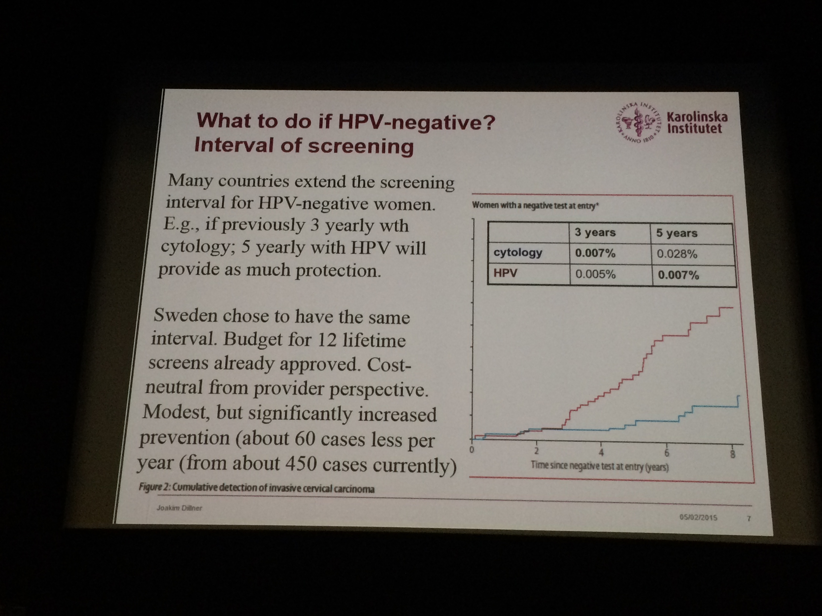
What to do if HPV-?
Interval of screening
3 yearly wth Cytology
5 yearly wth HPV
Screening interval for HPV – women is more political than scientific question.
  Balancing health gain, resource, side effect, and convenience
  From 3 to 10 years interval in different EU countries
Elfsfrom, 2014, bmj

Slide 22

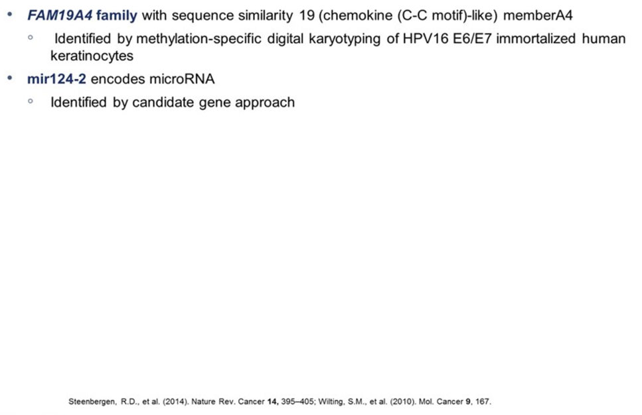
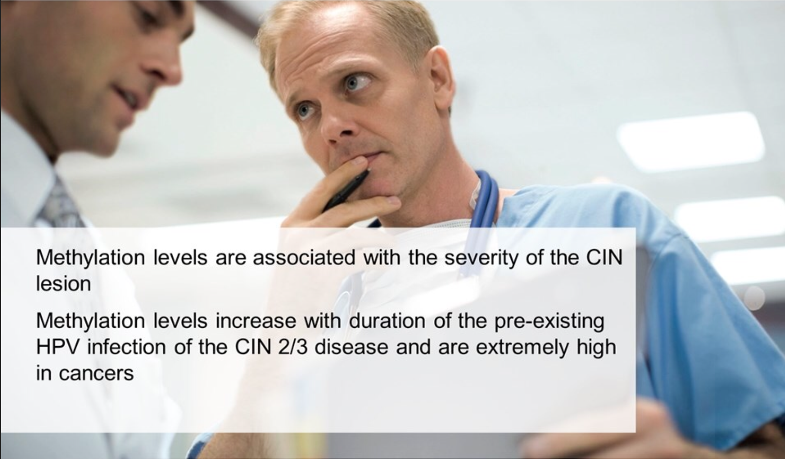
Methylation Markers in Cervical Carcinogenesis

Slide 23
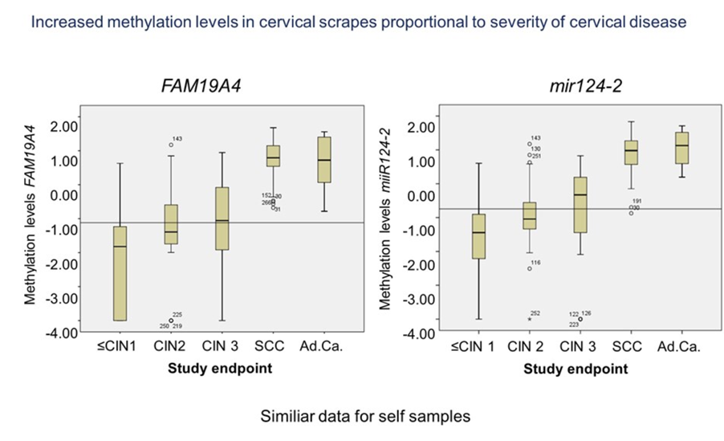
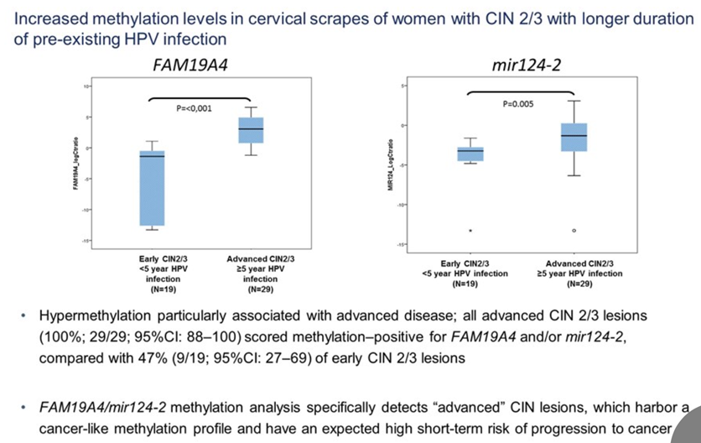

Slide 24
Current Screening Dilemma in Iran
Cotesting or HPV primary testing?
  Is there additional benefit to contesting vs. 1º HPV testing alone?
Which platform can be used in primary HPV Screening?
  Can we integrate all the screening
  Laboratory facilities & structures
  Importing lab, technology or domestic production?
    Test Validation; test specification
How do we perform screening and management guidance?

Slide 25
The last but not the least …
“ the biggest gain in reducing cervical cancer incidence and mortality would be achieved by increasing screening rate among WOMEN RARELY OR NEVER SCREENED …
Clinician, hospitals, health plans, and public health officials should seek to identify and screen these women.”

